Slide 1

Immigration: From Help to Harm
An oral presentation by Patrick Ignaut

Slide 2
What makes someone a Millennial?
Born between 1981 – 1996
Behaviors
Seeking feedback and recognition for achievements
Engaging in social interaction in the workplace
Advocating social changes
Strengths & Weaknesses
Tech literate
Adaptive
Creativity.
Characteristics
Values meaningful motivation
Challenges hierarchal status quo
Places importance on relationships with superiors
The Millennial Generation is the prime example of individuals living through the fallout from a generation raised in good times.
( Indeed ) ( Millennial )

Slide 3

Analytical questions for this presentation:
1. What were the results of who was immigrating to the United States?
2. Who now is immigrating to the United States?
3. What has that done to the millennial generation of the United States?
4. What did this new immigration do to the millennials of the origin nation?

Slide 4





KOLACHES
Who hasn’t heard of a Kolache?
Where did they come from?
They are a prominent food in the Czech Republic and Slovakia
Why are they everywhere in Texas?
Immigration!
( Kolache )

Slide 5
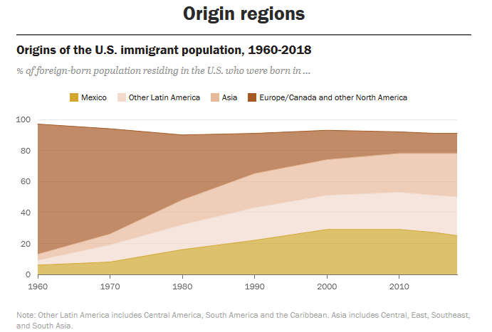
Primarily European/Canadian Prior to Millennial era
1965 Immigration and Nationality Act
Millennial generation begins during a time of great change
( Charts ) ( Homeland )

Slide 6
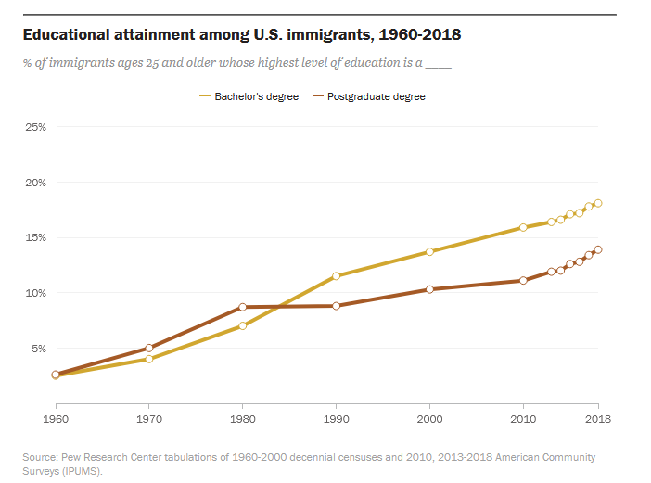
Initially immigration is lowered labor
Steady increase of education level as millennial generation begins
The prior generation was raised in an almost completely different world
( Charts ) ( Homeland )

Slide 7

( Gumball )

Slide 8
Works Cited
( Indeed ) Indeed Editorial Team. 10 Common Characteristics of the Millennial Generation. July 31, 2023, Indeed Research Center, https://www.indeed.com/career-advice/interviewing/10-millennial-generation-characteristics
( Gumball )Roy Beck. Immigration, World Poverty and Gumballs. Sustainable Population Australia, July 21, 2018, https://population.org.au/video/immigration-world-poverty-and-gumballs/
( Charts )Abby Budiman, Christine Tamir, Lauren Mora and Luis Noe-Bustamante. Origins of the U.S. immigrant population, 1960-2018. Pew Research Center tabulation of US decennial Consensus, https://www.pewresearch.org/hispanic/2020/08/20/facts-on-u-s-immigrants/
( Millennial )Michael Dimock. Defining Generations: Where Millennial ends and Generation Z begins. January 17, 2019, Pew Research Center, 1615 L St. NW, Suite 800 Washington DC, https://www.pewresearch.org/short-reads/2019/01/17/where-millennials-end-and-generation-z-begins/
( Homeland ) Pew Research Sources cross referenced with Department of Homeland Security https://www.dhs.gov/immigration-statistics
( Kolache )Joyous Apron. Texas Sausage Kolache. Pub. July 16, 2020. Updated September 21, 2023, https://www.joyousapron.com/texas-sausage-kolache/#Nutrition

